Slide 1
Guide optimization
Mads Bertelsen, ESS DMSC

Slide 2
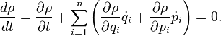
Brilliance transfer
Beam phase-space
ηx
Figure of Merit
Phase space diagrams, space and divergence pairs (x,ηx) (y,ηy)
Luiville’s theorem states the phase-space density does not change
The brilliance transfer is the fraction of the original phase-space density that is left at a given point, for a given phase-space area
x

Slide 3
Losses in supermirrors
Losses due to reflectivity

Slide 4
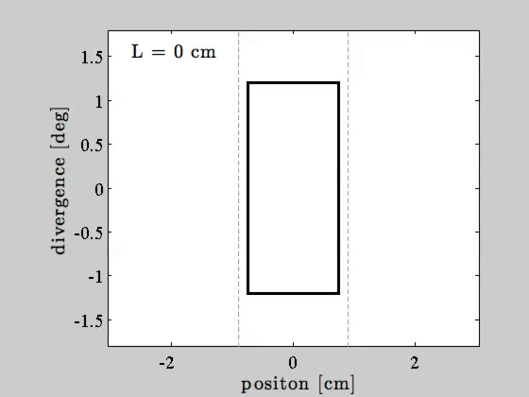
Brilliance transfer after guide
Brilliance transfer can not exceed fraction of target that is covered by beam!
Divergence
z
v
𝜂x
x

Slide 5
Consequence of brilliance transfer
Limit to maximum brilliance transfer with closed figure of merit
Must be a maximum amout of phase-space that should be extracted from source

Slide 6
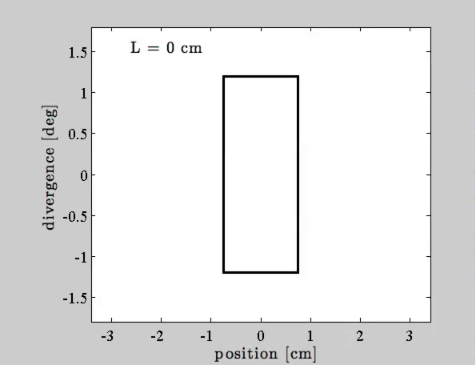
Backpropagation from sample to guide
Sample
βfocusing
S
𝜽
U
L
U
U = S + 2Ltan(𝜽)
V(βfocusing) = 2𝜽S

Slide 7
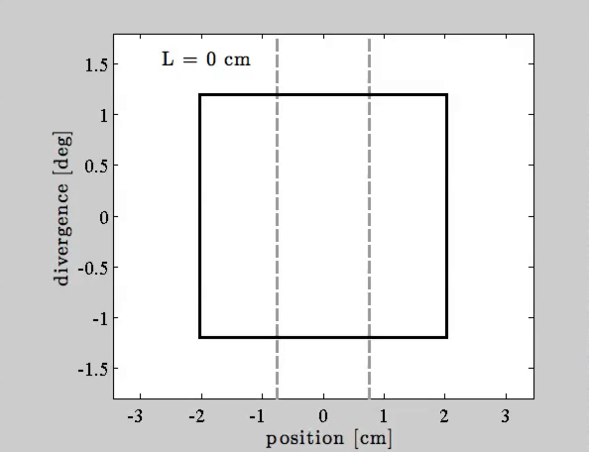
Propagation from guide to sample
Sample
βmultiple
S
U

Slide 8
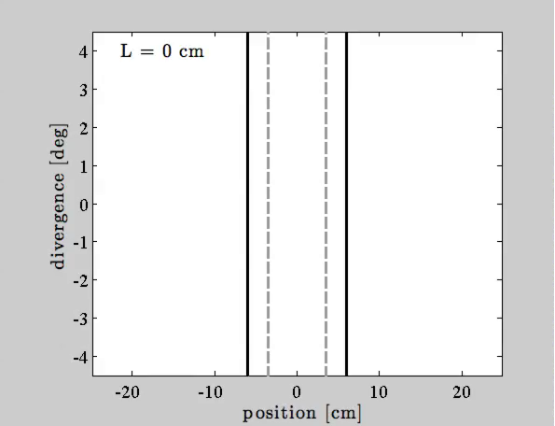
Propagation from moderator to guide
Moderator
M
𝜶
L
W
V(𝜶) = WM/L

Slide 9
Minimalist principle
Width of the end of the guide
U = S + 2Ltan(𝜽)
Phase-space received by guide
V(𝜶) = WM/L
Phase-space needed by guide
V(β) = 2𝜽U
Minimalist constraint
V(𝜶) = V(β) ⇒ 2𝜽U = WM/L
“Don’t put more food on your plate than you can eat!”

Slide 10
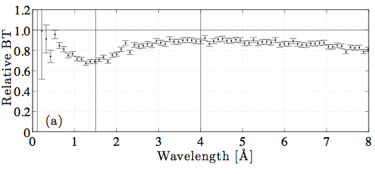
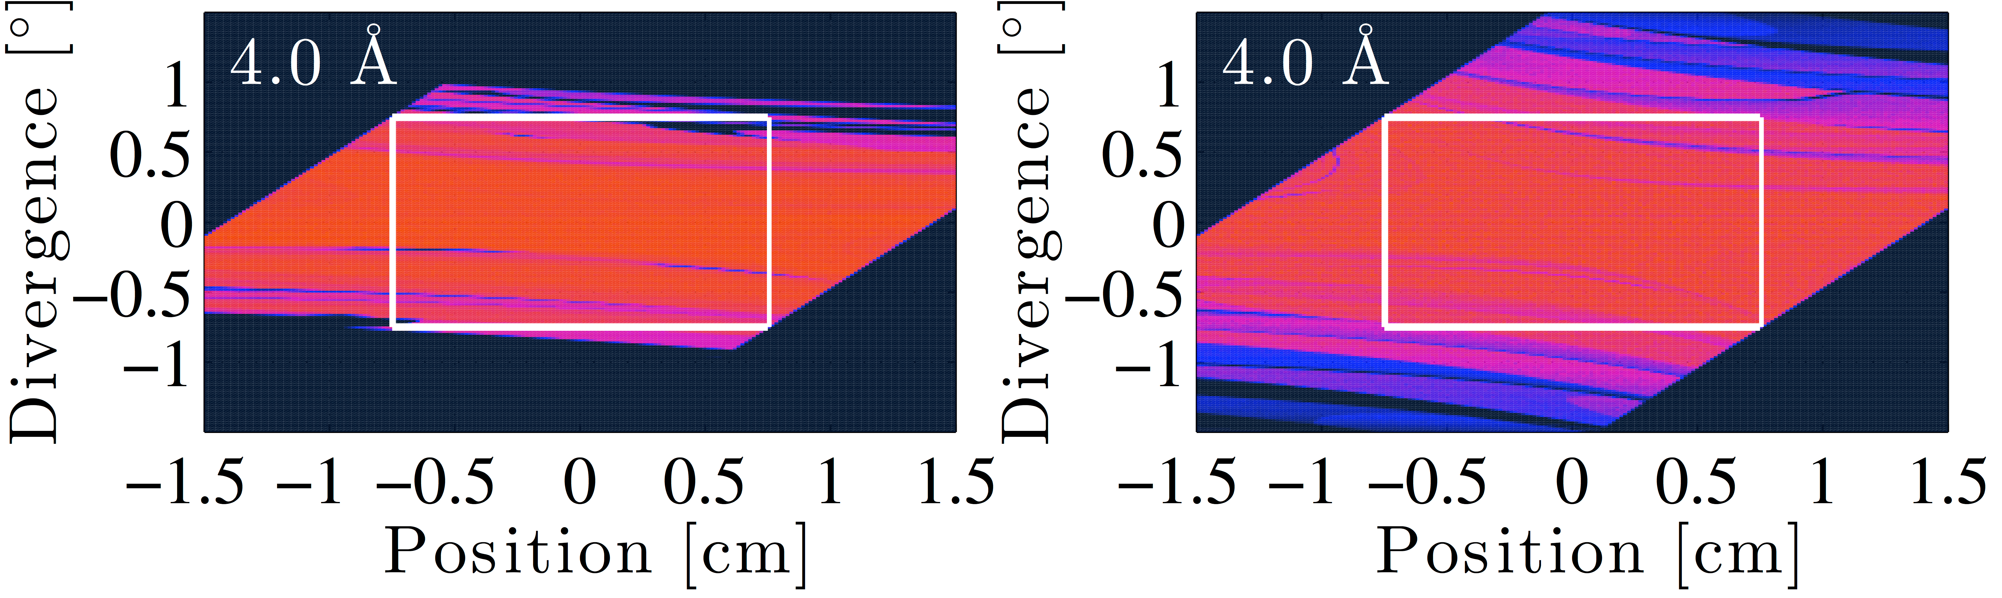
Minimalist principle
Lower brilliance transfer, but still high
Lower background
Control over maximum divergence
Minimalist Principle
Brute force

Slide 11


guide_bot idea
Neutron scattering facilities has a large requirement for guide optimization at start-up and in upgrade phases
Demands and requirements change rapidly
Many viable alternatives for each instrument
guide_bot is an answer to this situation
iFit

Slide 12
guide_bot
Input Job description
Geometry string
Optimization
Optimization of the guide
Output
Guide characterization
Scan of optimizations
Description of desired beam
Instrument length
Facility information
Computing options
Coating description (not optimized)

Slide 13

guide_bot
Input Job description
Geometry string
Optimization
Optimization of the guide
Output
Guide characterization
Scan of optimizations
S

Slide 14

guide_bot
Input Job description
Geometry string
Optimization
Optimization of the guide
Output
Guide characterization
Scan of optimizations
S S

Slide 15
guide_bot
Input Job description
Geometry string
Optimization
Optimization of the guide
Output
Guide characterization
Scan of optimizations
S S E S

Slide 16
guide_bot
Module | Description
S | Straight guide
E | Elliptic guide
P | Parabolic guide
G | Gap
C | Curved guide
K | Kink
Selene | Selene guide system
Slit | Slit
M | Monochromator
Input Job description
Geometry string
Optimization
Optimization of the guide
Output
Guide characterization
Scan of optimizations
Contributed by Leland Harriger, NIST, USA

Slide 17
guide_bot
S C(start=6) S(maxlength=20)
Input Job description
Geometry string
Optimization
Optimization of the guide
Output
Guide characterization
Scan of optimizations
Code | Function
length | Length of the module
start | Start of the module
StartWidth | Start width of a module
StartHeight | Start height of a module
EndWidth | End width of a module
EndHeight | End height of a module

Slide 18
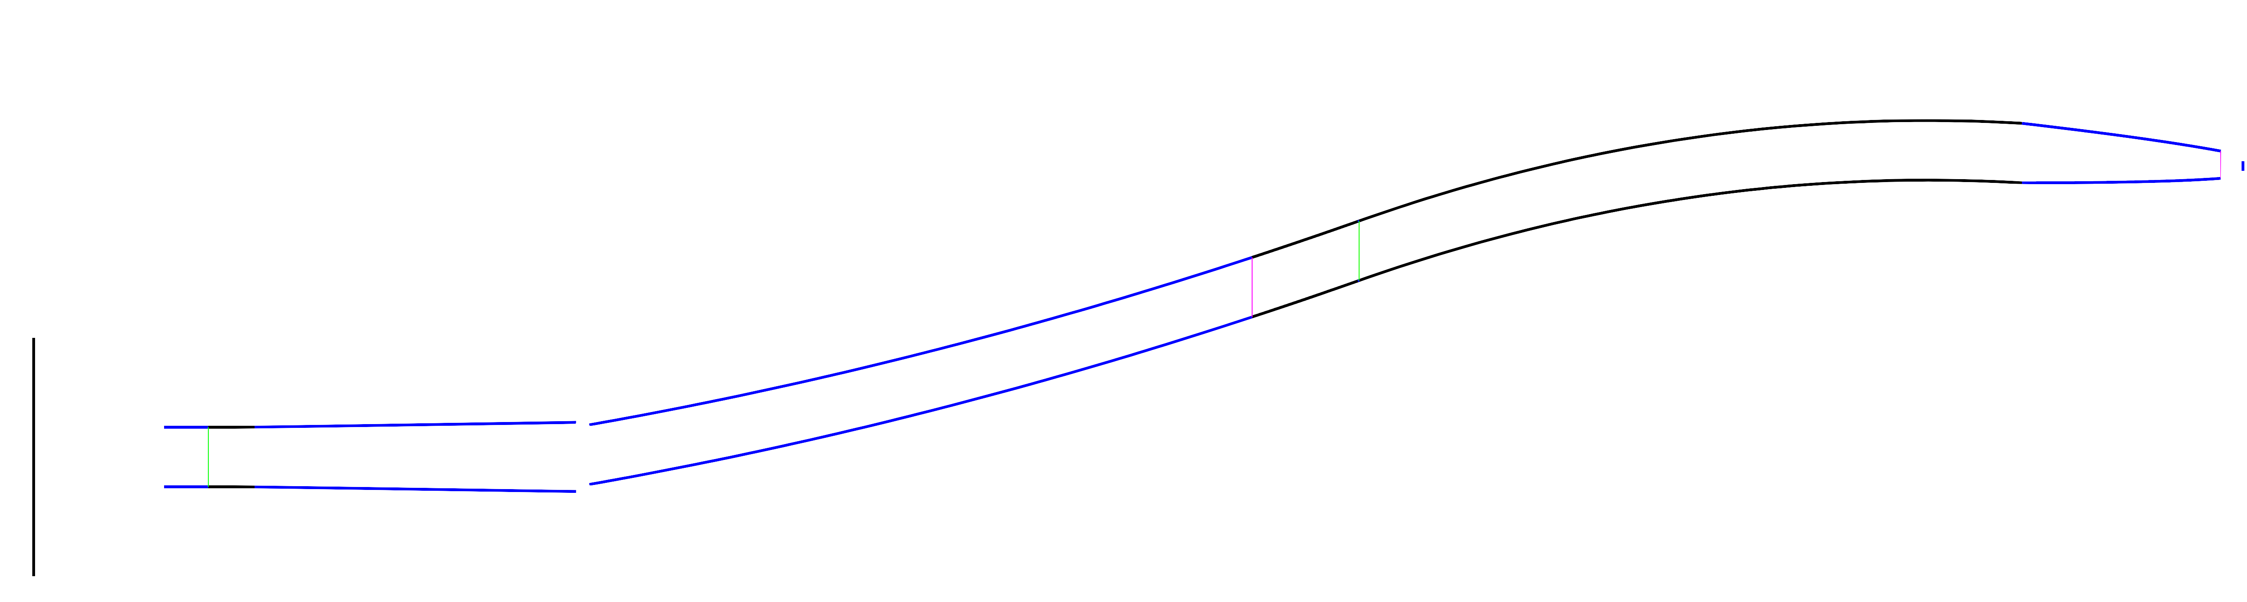
guide_bot
Additional options to control escaping line of sight
Input Job description
Geometry string
Optimization
Optimization of the guide
Output
Guide characterization
Scan of optimizations

Slide 19
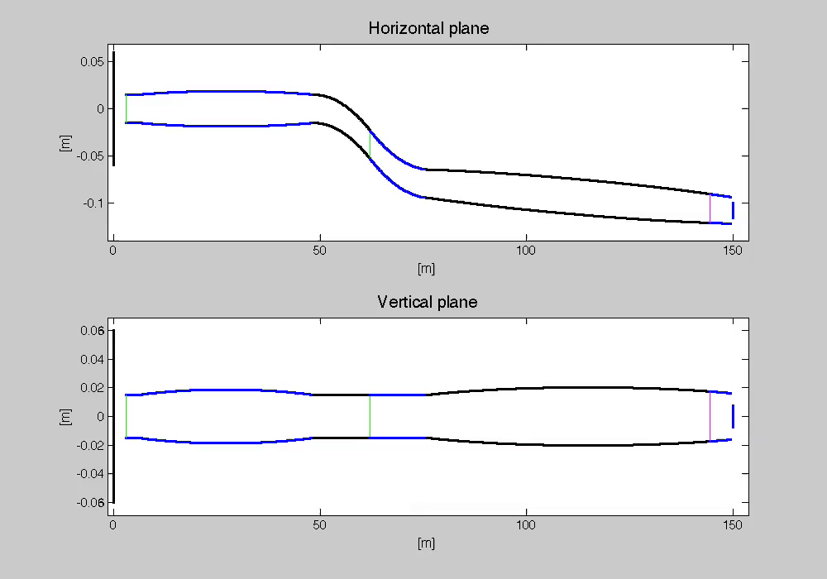
guide_bot
Input Job description
Geometry string
Optimization
Optimization of the guide
Output
Guide characterization
Scan of optimizations

Slide 20
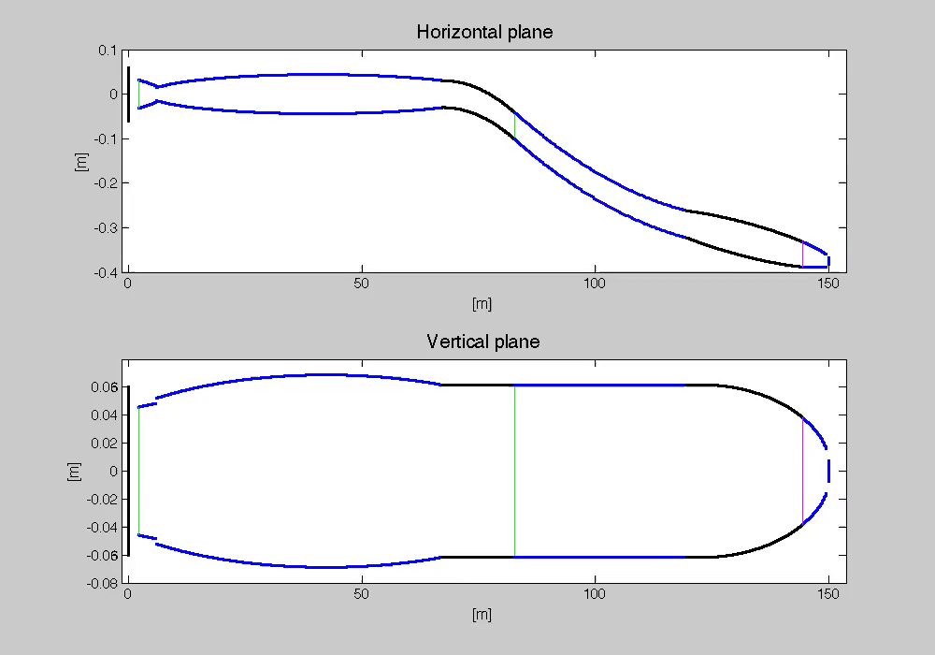
guide_bot
Input Job description
Geometry string
Optimization
Optimization of the guide
Output
Guide characterization
Scan of optimizations

Slide 21
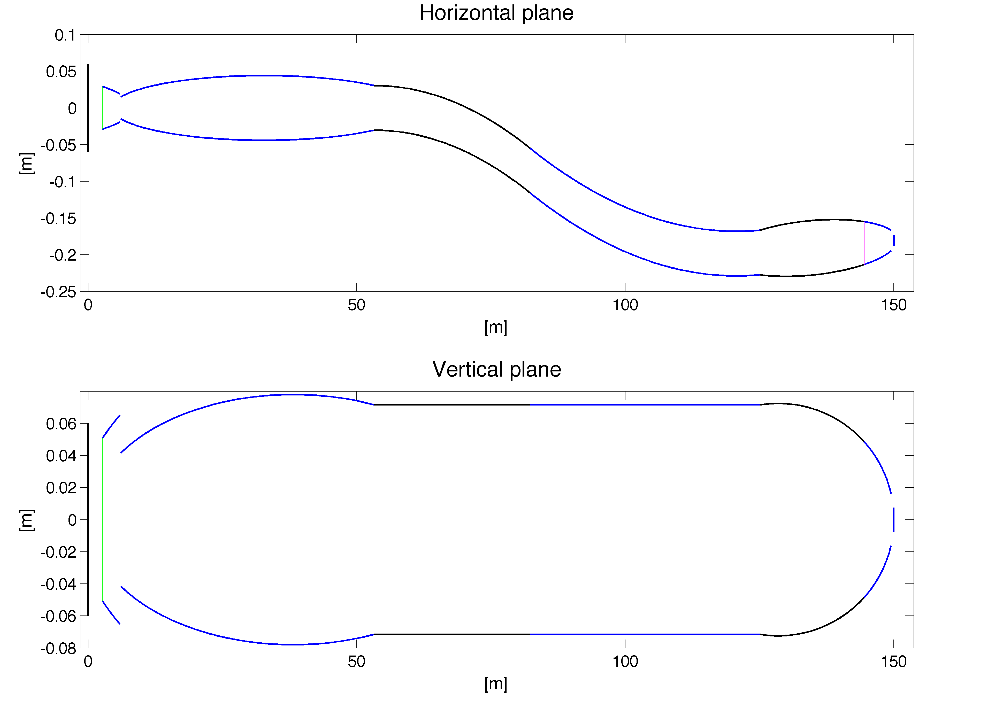
guide_bot
Input Job description
Geometry string
Optimization
Optimization of the guide
Output
Guide characterization
Scan of optimizations

Slide 22
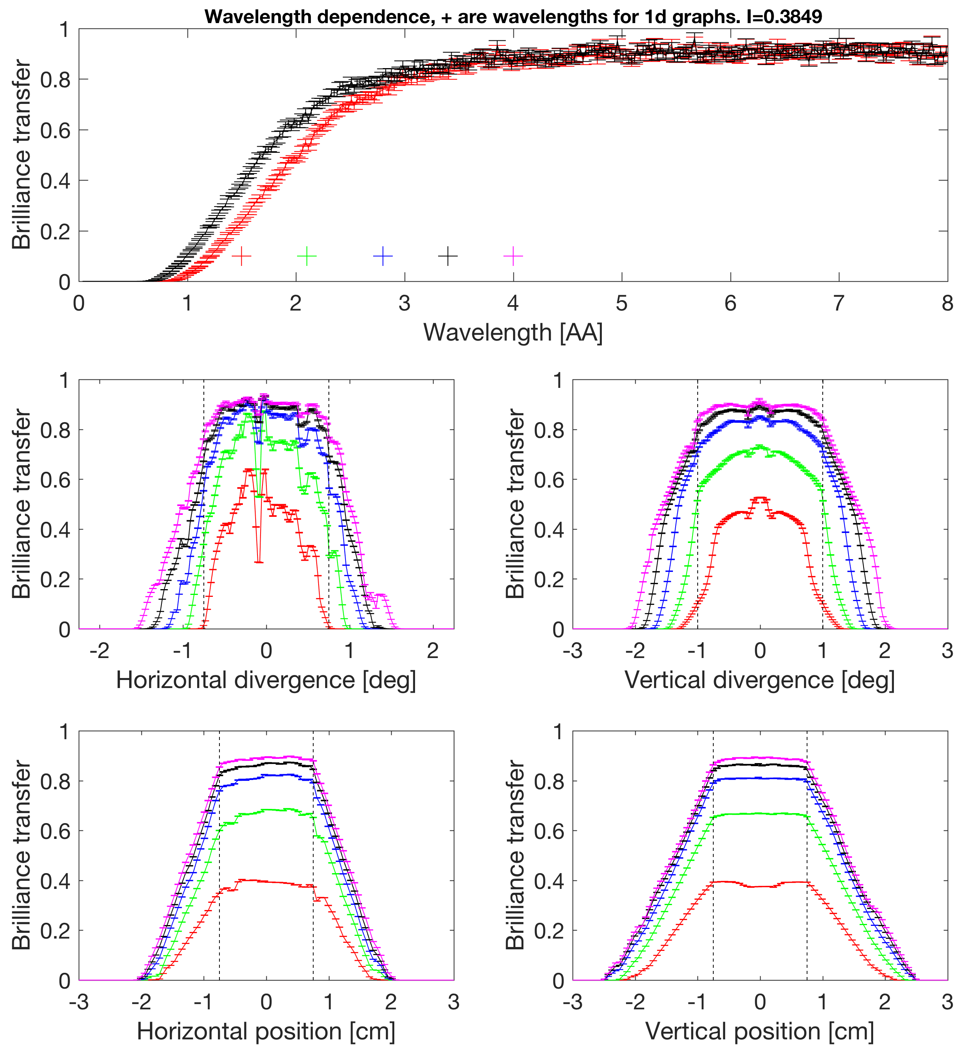
guide_bot
Used parameters
Divergence H | ±0.75°
Divergence V | ±1.0°
Size H | 1.5 cm
Size V | 1.5 cm
Wavelength min | 1.5 Å
Wavelength max | 4.0 Å
Guide - sample | 0.5 m
Moderator - sample | 150 m
m value for coating | 3

Slide 25
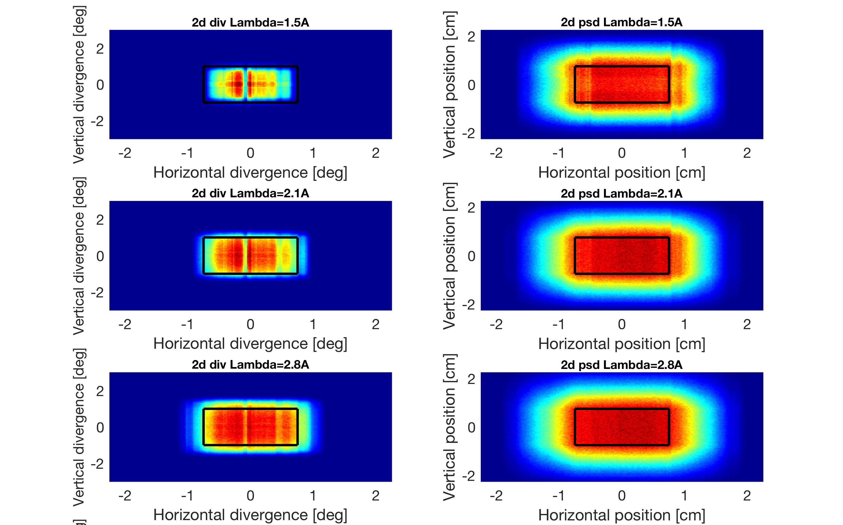

Slide 26
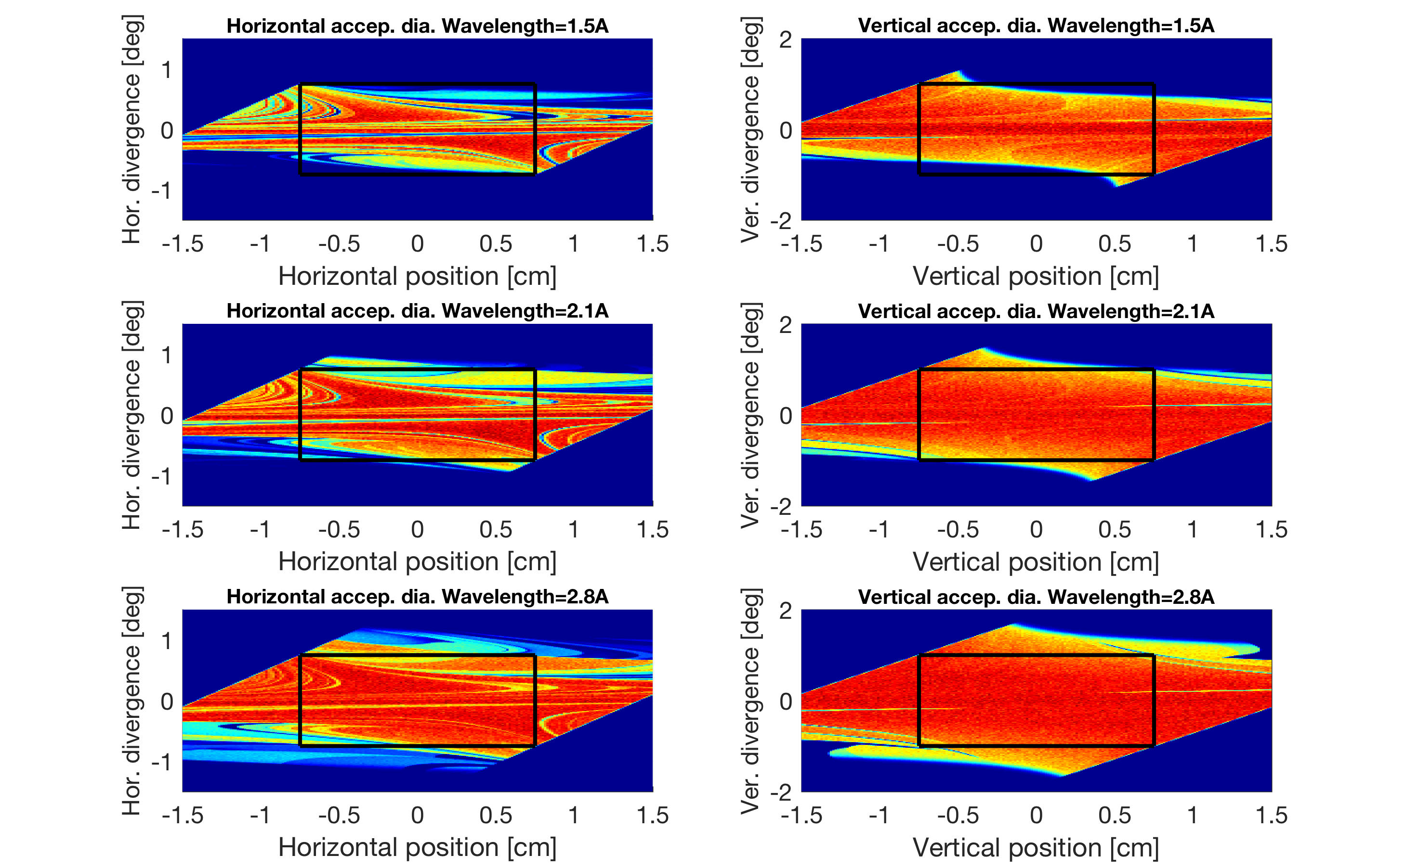

Slide 27
guide_bot
Input Job description
Geometry string
Optimization
Optimization of the guide
Output
Guide characterization
Scan of optimizations
Many geometry strings are usually optimized in parallel
Little book of guide reports to choose from!

Slide 28
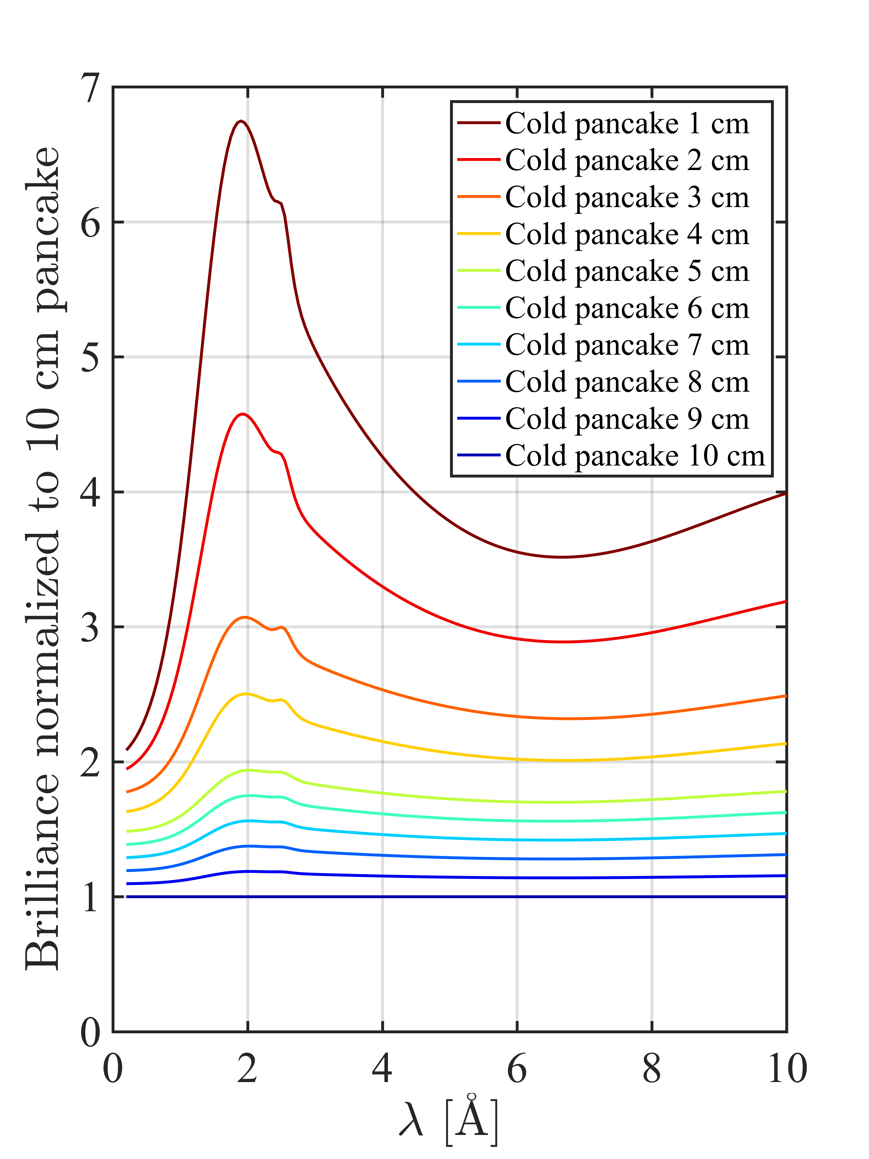
guide_bot
Scan dimensions Moderator dimensions Divergence requirement Sample size
Used in connection with ESS moderator decision
Input Job description
Geometry string
Optimization
Optimization of the guide
Output
Guide characterization
Scan of optimizations

Slide 29
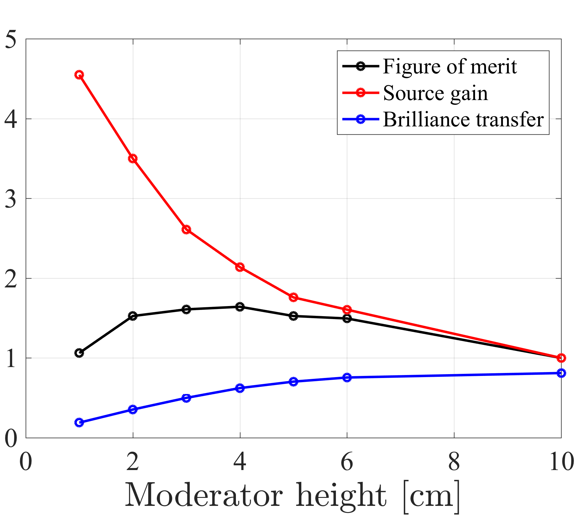
guide_bot
C-SPEC results
Input Job description
Geometry string
Optimization
Optimization of the guide
Output
Guide characterization
Scan of optimizations

Slide 30
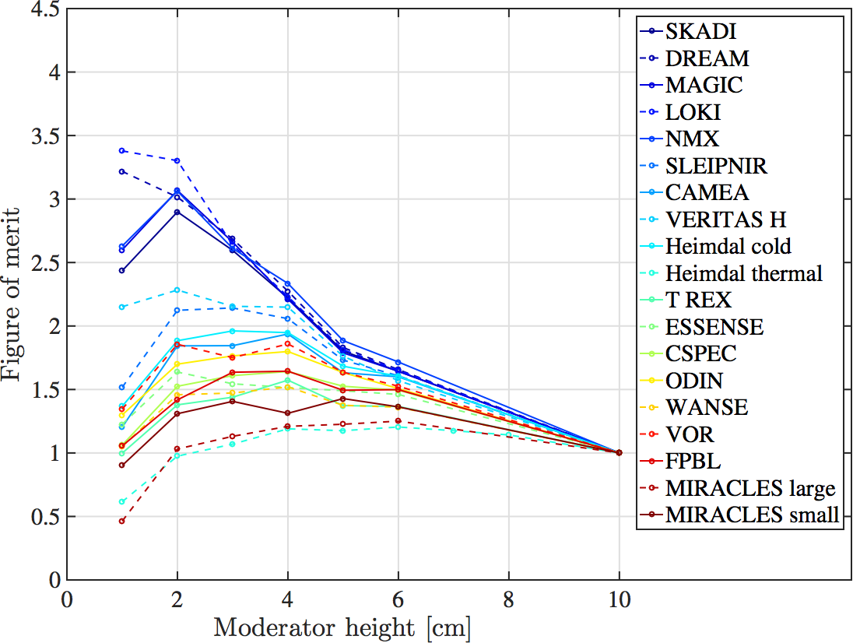
guide_bot
Input Job description
Geometry string
Optimization
Optimization of the guide
Output
Guide characterization
Scan of optimizations

Slide 31
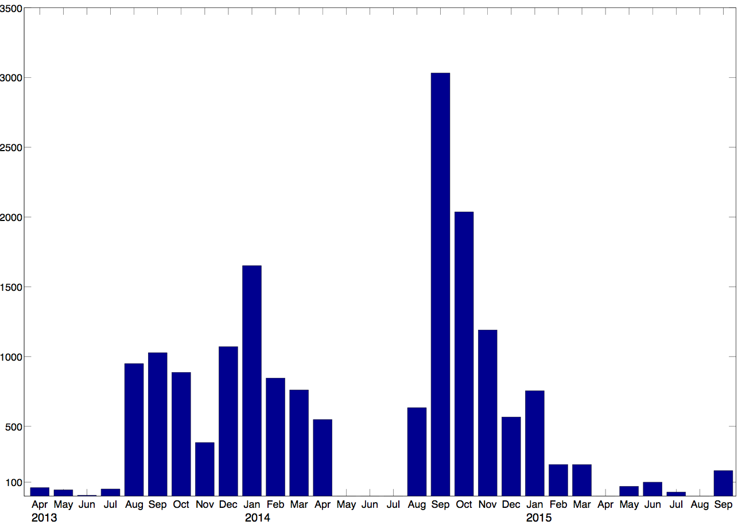
My guide_bot use
Performed more than 20000 guide optimizations
Tens of millions of McStas simulations
Guides for several ESS instruments
Used at PSI in Switzerland
Used at NIST in America
Guide simulations per month
3000
2000
1000

Slide 32
Code on github
The project is available on github
https://github.com/mads-bertelsen/guide_bot
Not part of my current employment, not very active but available

Slide 33
Coating Writer
Student project by Martin Olsen at University of Copenhagen
Optimizes coating for performance or performance per cost

Slide 34
Conclusion
Guide design is about conserving brilliance transfer while avoiding background
The Minimalist Principle provides some bounderies and understanding
guide_bot automates McStas guide optimizations on supported clusters
Even without supported cluster, guide_bot can generate instrument files
Requires MATLAB license

